Slide 1
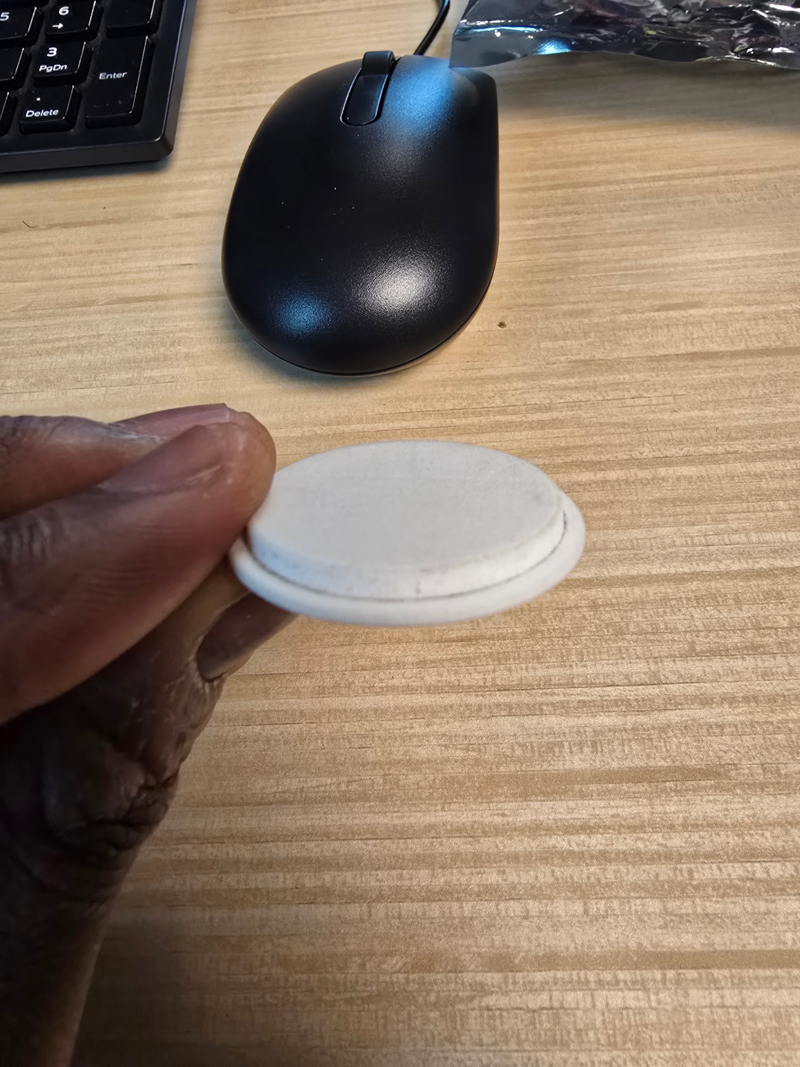
Bean Testing
Start with no beans in the Beanis. Take a screenshot.
To keep consistent, I will be picking up and inverting the Bean-tube to simulate moving the beans around even without any beans in there. Take another screenshot after movement so you have a before shaking and after shaking picture.
Add one bean. And repeat the process
Continue up until desired beans are in the bean-tube, repeat with other flavors and or lens combinations. (I will be focusing on the lens the bean-tube was modeled for)

Slide 2
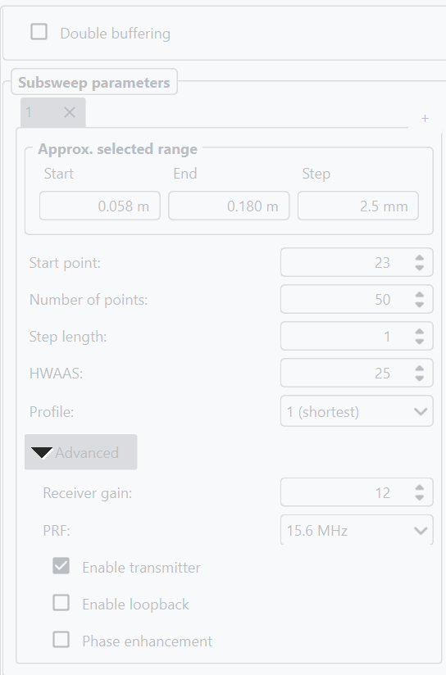
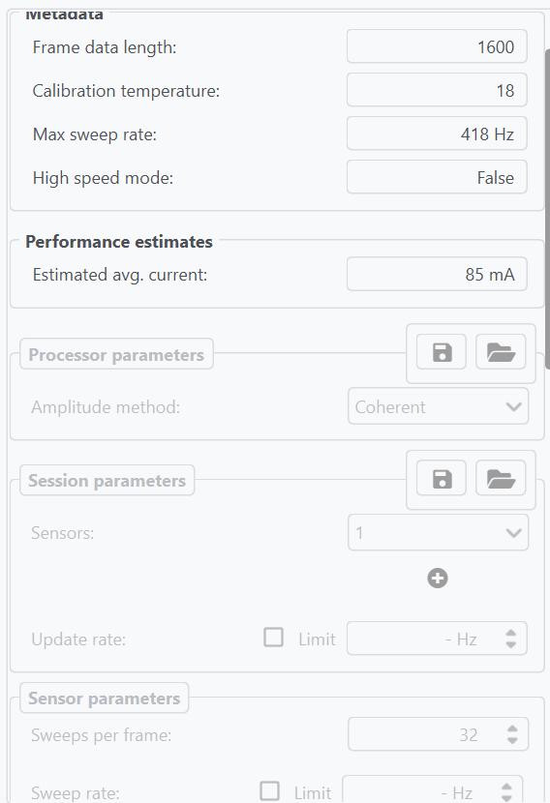
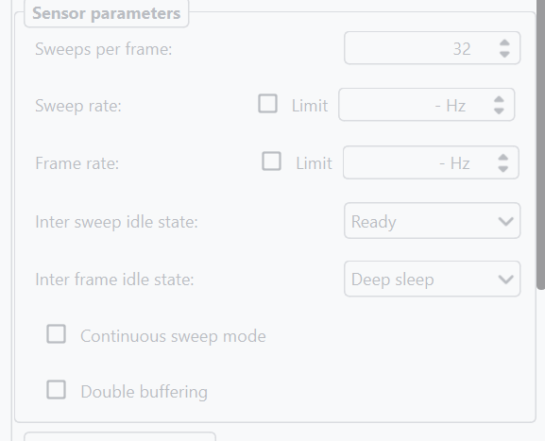
Settings
Notes:
Profile
Profiles are used to set the transmitted pulse length in discreet steps. The higher the Profile, the longer the transmitted pulse length.

Slide 3
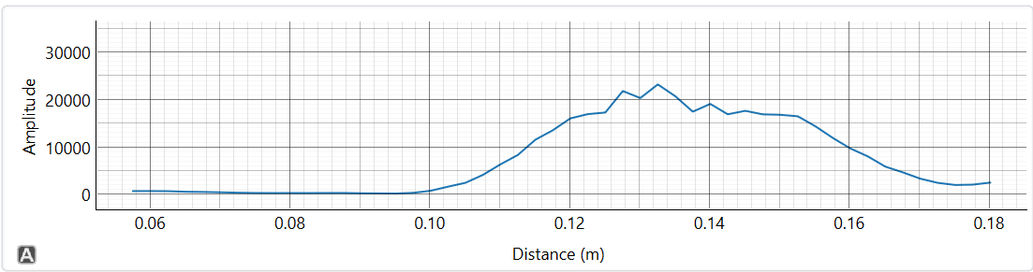
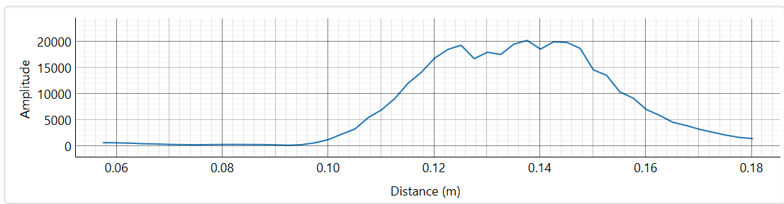
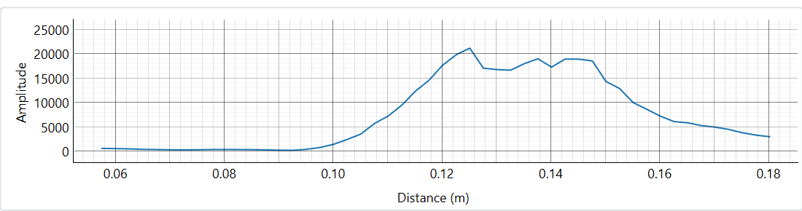
Notes:
Image 1: Tailored no beans roast rite 8.8%
Image 2: Comicovel no beans roastrite 7.6%
Image 3 : Sweet marias no beans Tested on roastrite 9.5%

Slide 4
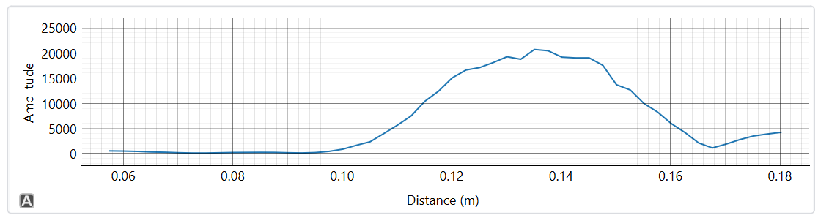
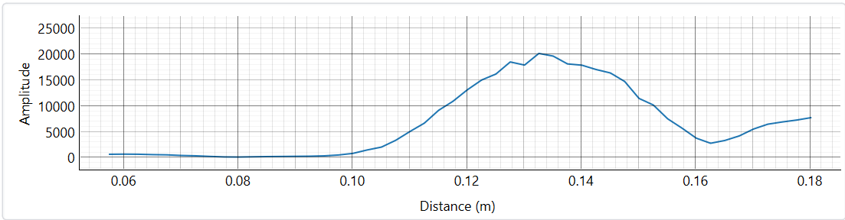
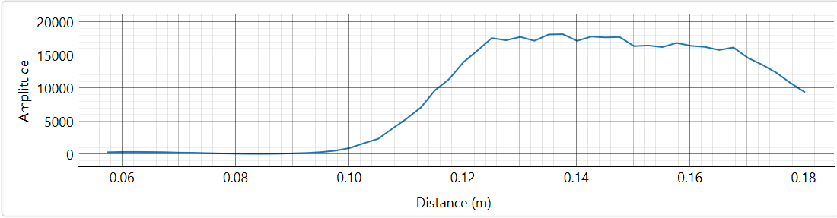
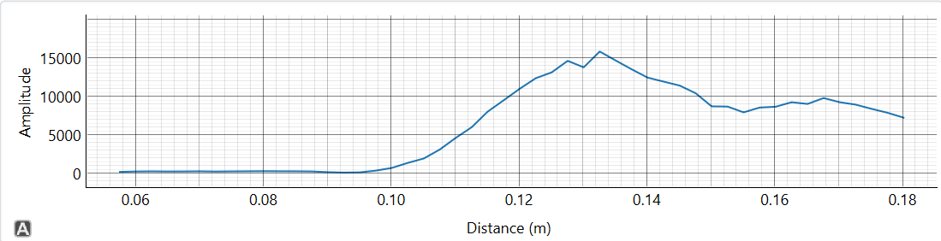
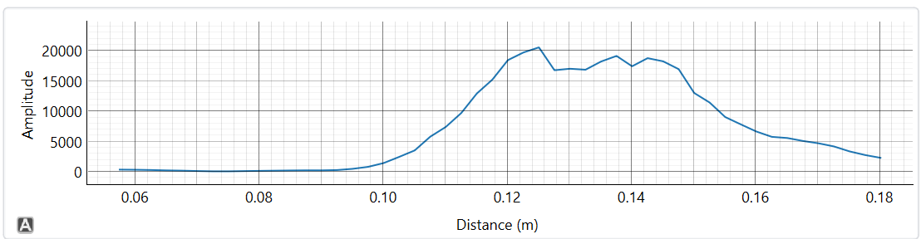
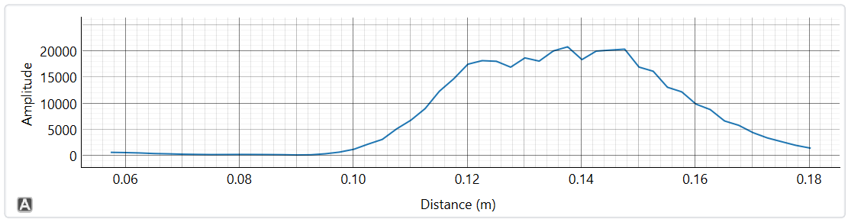
One bean
Notes:
Tailored- Image 1 : Before Image 2: After
Comicovel Image 1: Before Image 2: After
Sweet marias Image 1: Before Image 2: After

Slide 5
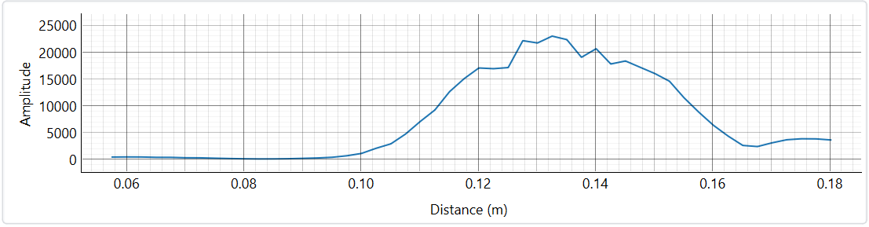
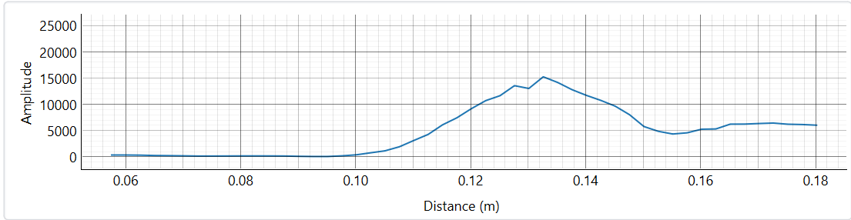
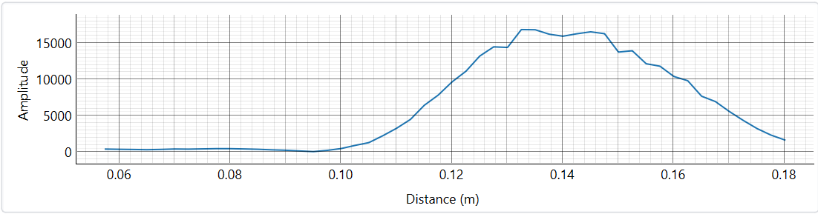
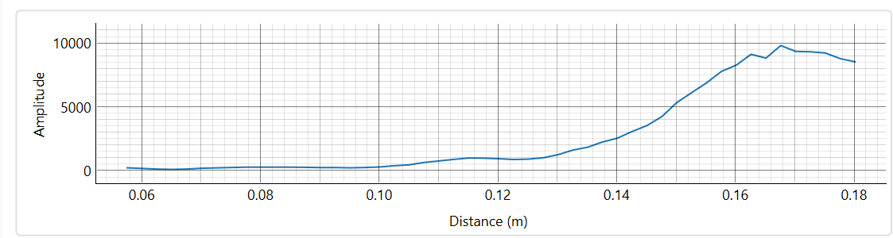
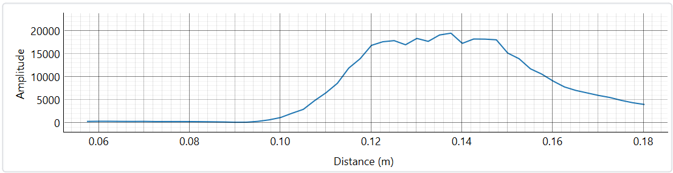
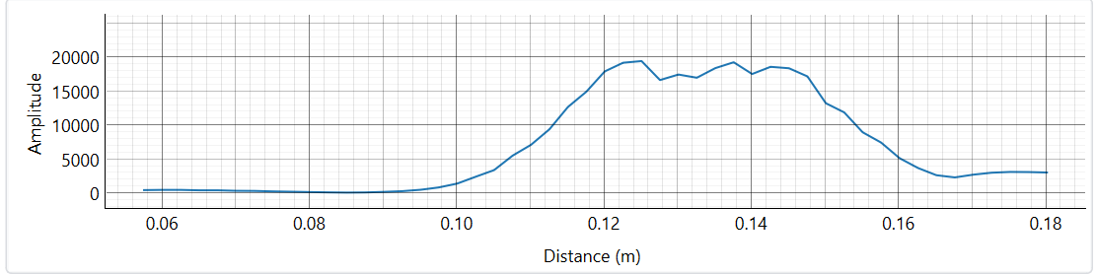
Three beans
Notes:
Tailored- Image 1 : Before Image 2: After
Comicovel Image 1: Before Image 2: After
Sweet marias Image 1: Before Image 2: After

Slide 6
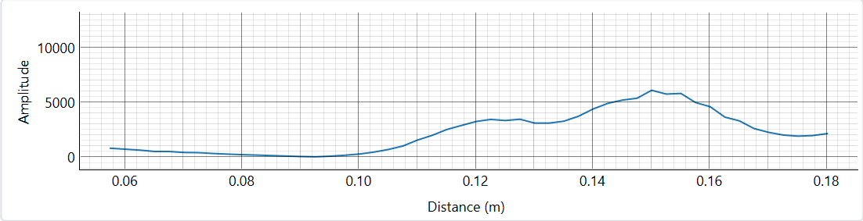
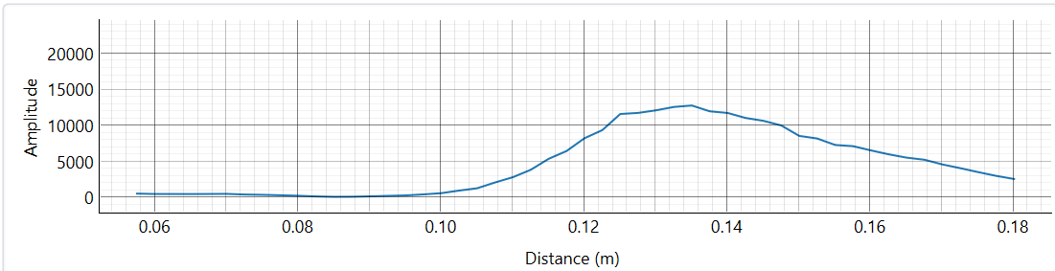
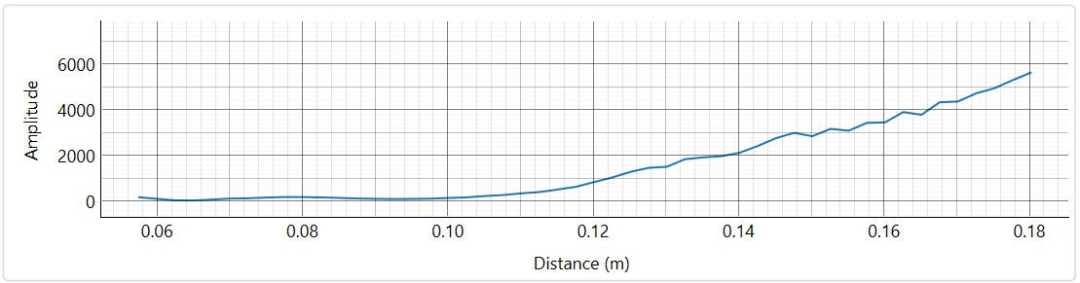
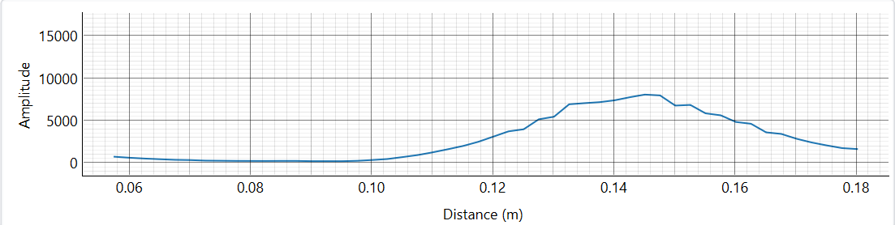
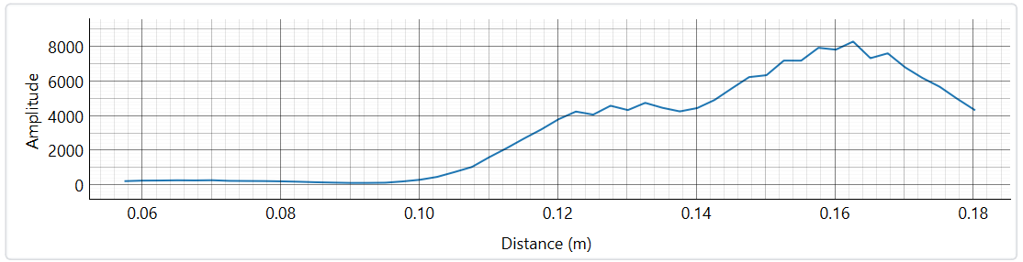
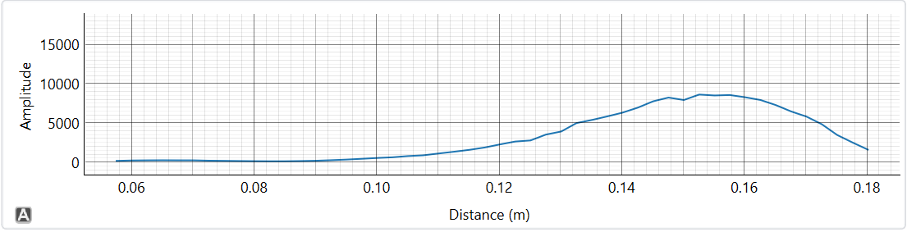
Five beans
Notes:
Tailored- Image 1 : Before Image 2: After
Comicovel Image 1: Before Image 2: After
Sweet marias Image 1: Before Image 2: After

Slide 7
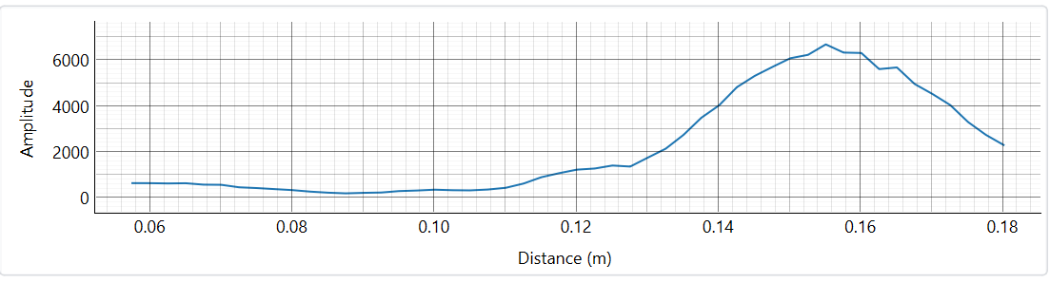
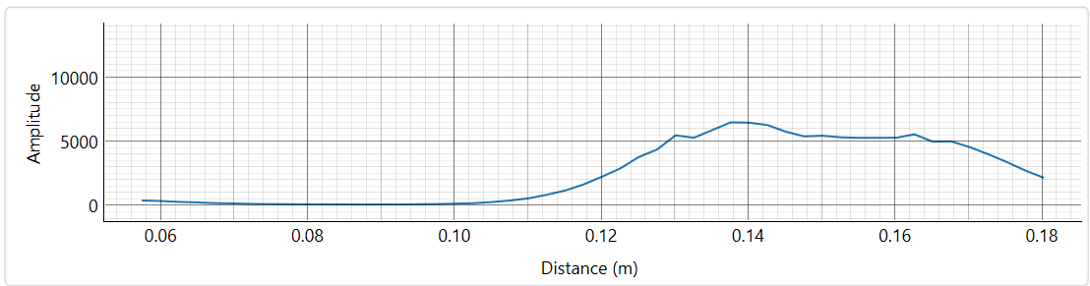
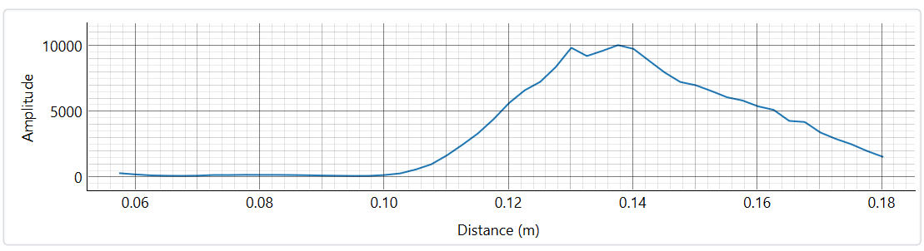
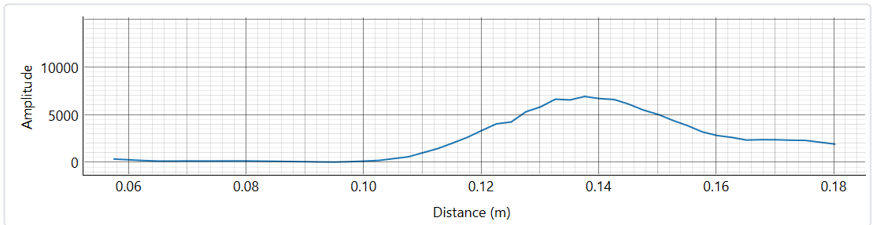
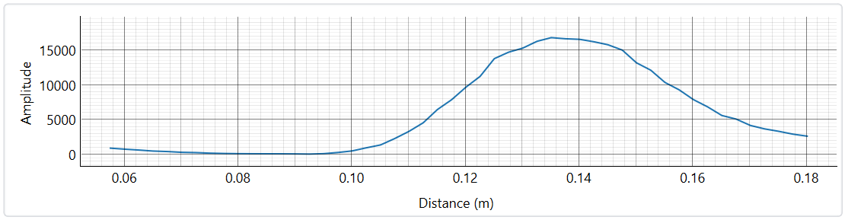
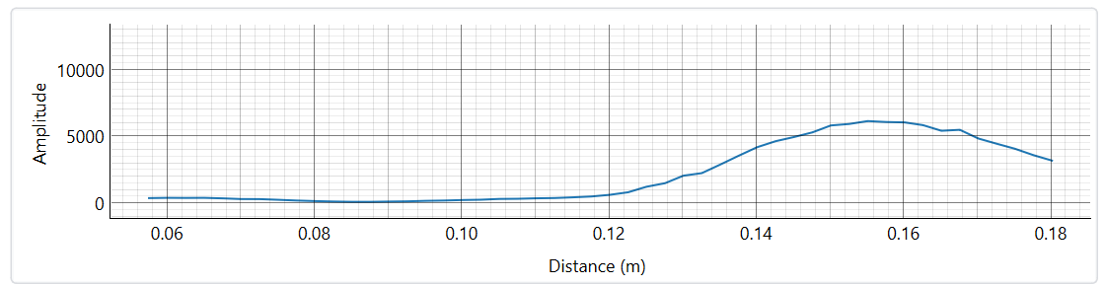
Seven Beans
Notes:
Tailored- Image 1 : Before Image 2: After
Comicovel Image 1: Before Image 2: After
Sweet marias Image 1: Before Image 2: After

Slide 8
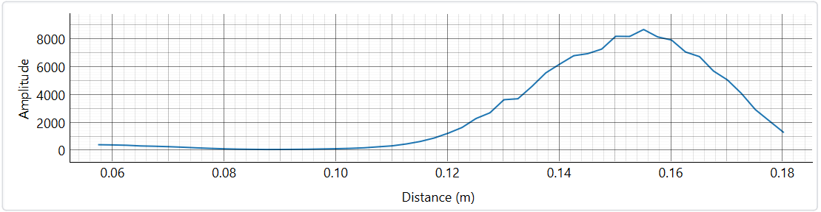
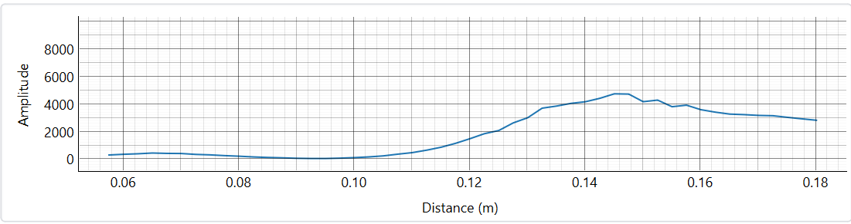
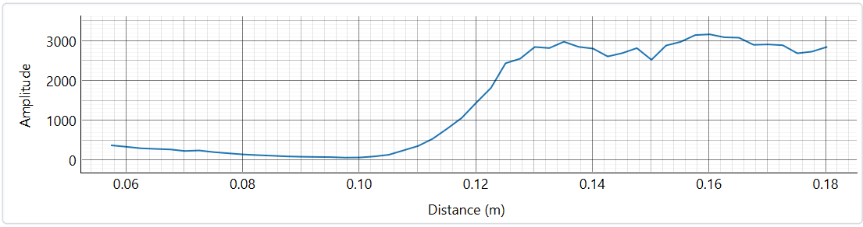
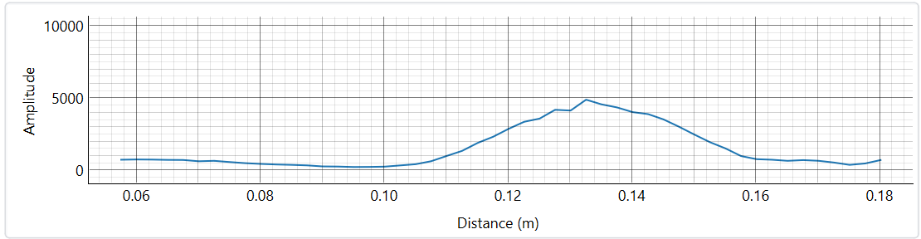
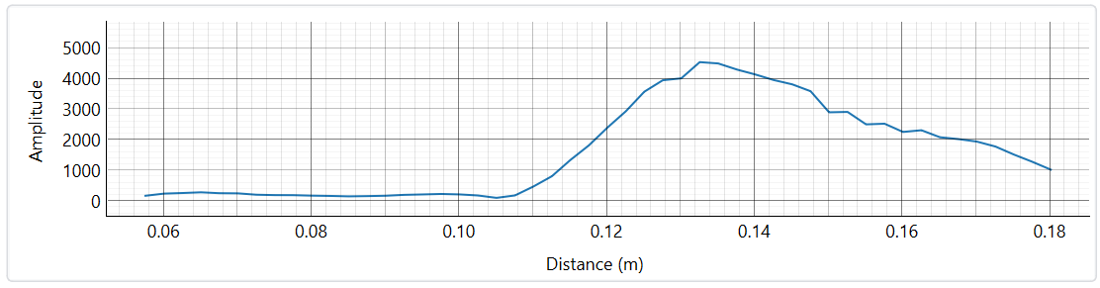
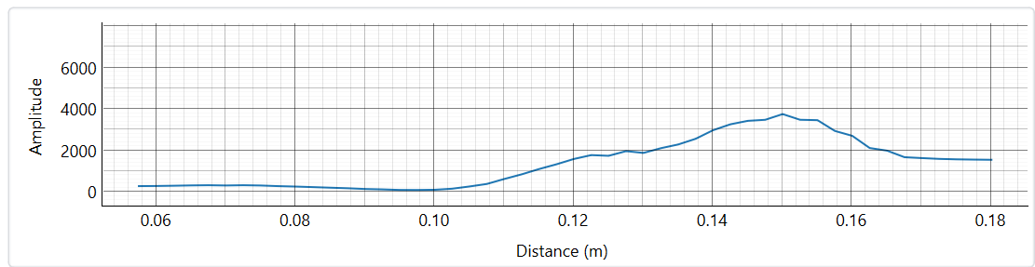
Nine Beans
Notes:
Tailored- Image 1 : Before Image 2: After
Comicovel Image 1: Before Image 2: After
Sweet marias Image 1: Before Image 2: After

Slide 9
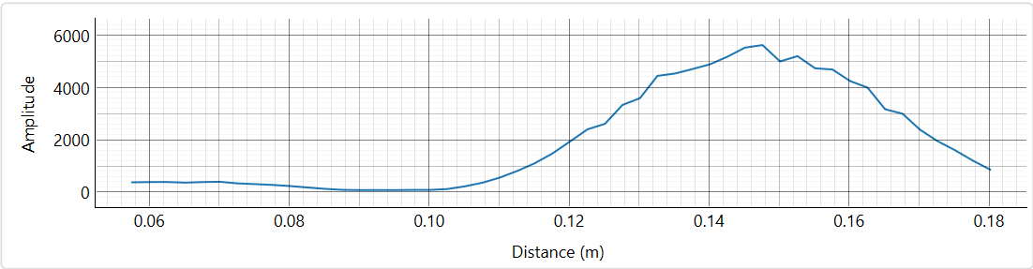
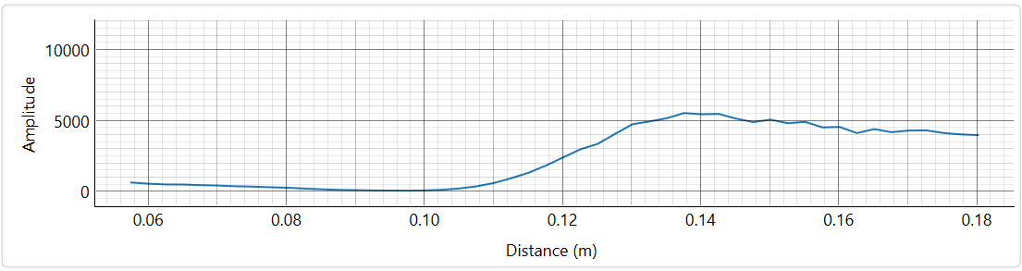
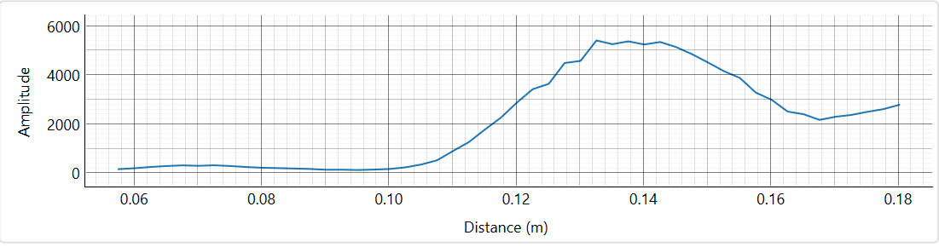
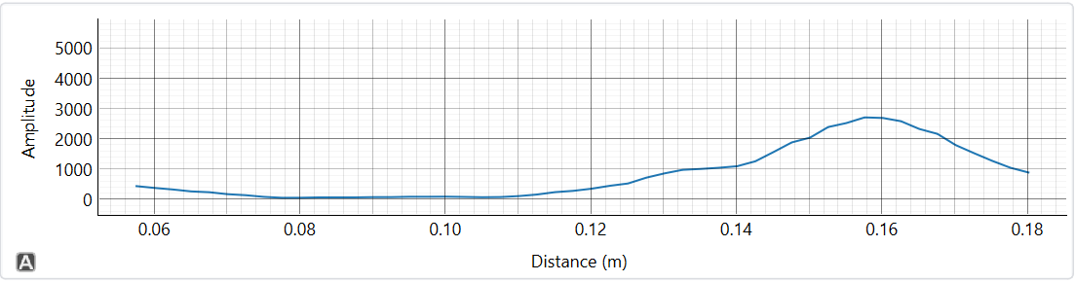
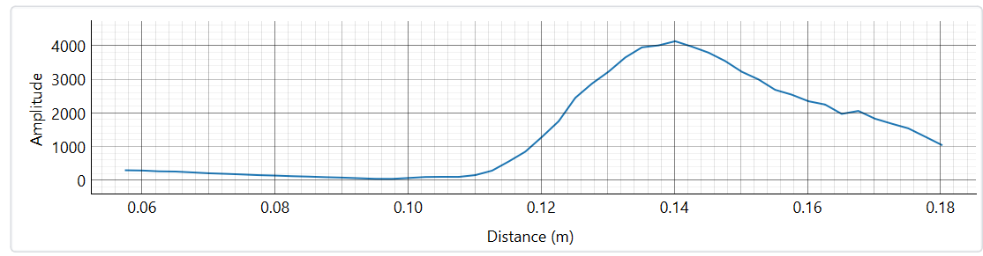
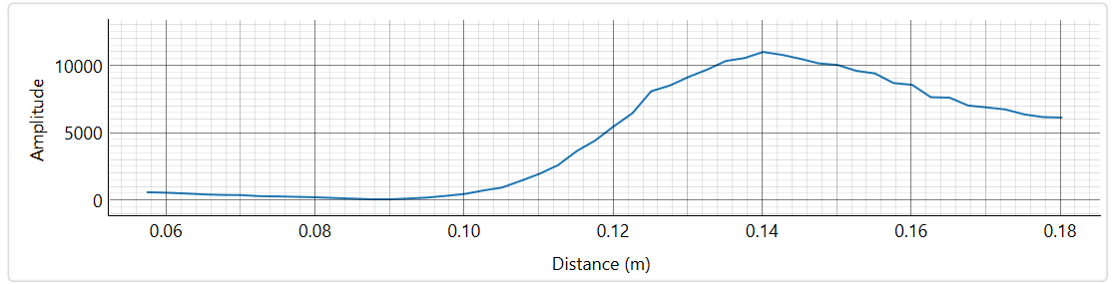
Ten Beans
Notes:
Tailored- Image 1 : Before Image 2: After
Comicovel Image 1: Before Image 2: After
Sweet marias Image 1: Before Image 2: After

